Slide 1


Toronto Neighborhood Analysis Finding ideal locations for a multi-cuisine restaurant setup

Slide 2
Cleaning and Analysing Toronto Crime Dataset from Kaggle
We start by removing any null valued rows.
We selected columns with features that aid us in reaching the output.
We sum all crimes in a neighbourhood to get the total crime for each neighbourhood.

Slide 3
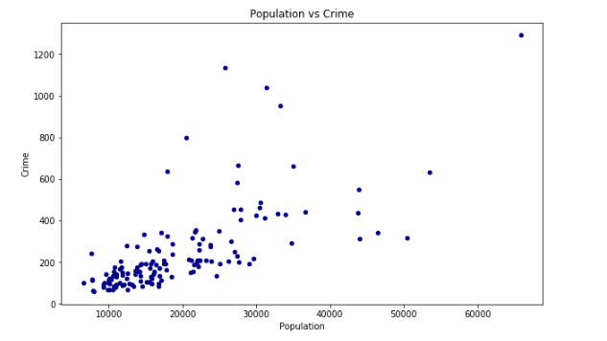
Analysis Methodology
We check whether Population and Crime have a proper linear correlation through a scatter plot. We see its not exactly linear, so it may contain neighbourhoods with low population and high crime, or even high population with low crime, which is what we are looking for.

Slide 4
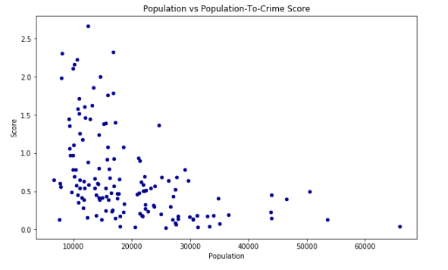
Analysis Methodology
So now we add a column ’Ratio’ which is population/crime*2, which gives us a ratio to consider when filtering for good neighbourhoods.
Higher the ratio, better the neighbourhood in terms of crime.

Slide 5
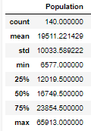

Analysis Methodology
Now we filter the neighbourhoods based on their population average first and then their population-to-crime ratio.
We take > 20,000 Population and > 0.4 Ratio.

Slide 6
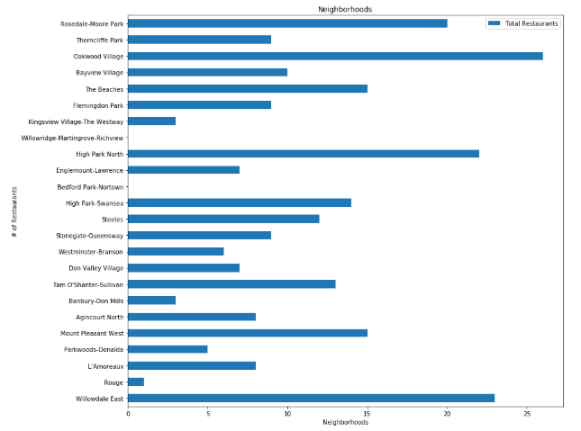
Analysis Methodology
We use the foursquare API to find the venues nearby each neighbourhood within 1km radius.
We use one hot encoding to get the count of different venue categories per neighbourhood.
Then we filter venue categories to only restaurants.
Then we group by the data on the column ‘neighbourhood’ to get the total number of restaurants per neighbourhood.

Slide 7
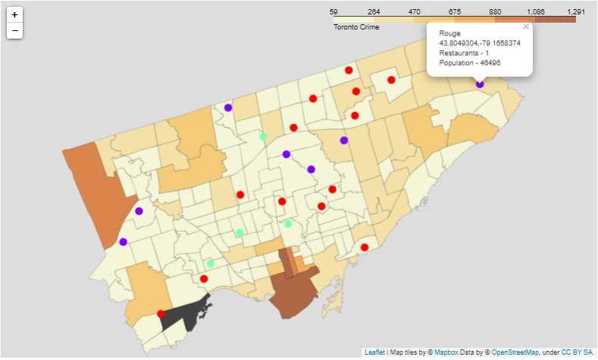
Analysis Methodology
Running K-means algorithm over the column ‘Total Restaurants’ with k=3, gives us 3 clusters of low, medium and high restaurant count.
This is our final analysed data.

Slide 8
Result & Conclusion
From these clusters, for a person new to the restaurant business, we can recommend clusters 1 and 0, because these clusters have low and medium restaurant counts.
People already well established in the restaurant business could also look into neighbourhoods from cluster 2 (they are high in restaurant count and generally not recommended due to high competition).
These recommendations are based on the only 2 parameters I have considered (population and crime). In reality, there are much more factors to consider, before choosing a neighbourhood for setting up a restaurant.

Slide 9
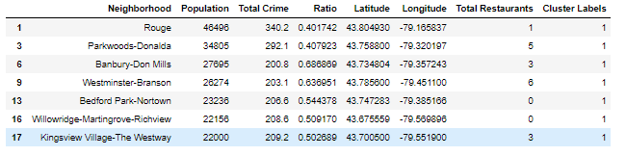
Result & Conclusion
Cluster 1 (Low Restaurant Count)

Slide 10
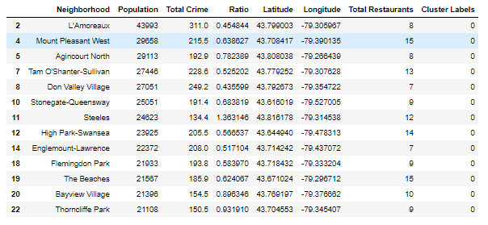
Result & Conclusion
Cluster 0 (Medium Restaurant Count)

Slide 11
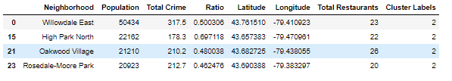
Result & Conclusion
Cluster 2 (High Restaurant Count)

